Slide 1
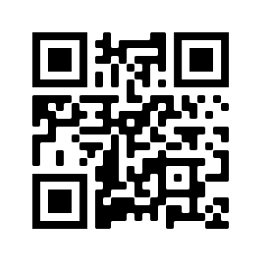
We’ll be starting shortly!
Exclusive Trainings by Zenika and Trent!
To help us run the workshop smoothly, please kindly:
Submit all questions using the Q&A function
If you have an urgent request, please use the “Raise Hand” function
Thank you!
https://bit.ly/tgczenika

Slide 2
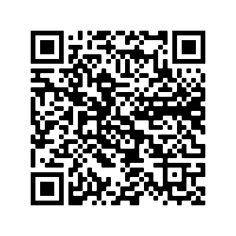



Today’s slides

Slide 3



Trent Global College
Imda Funded Tech Bootcamp
http://bit.ly/codingdip

Slide 4



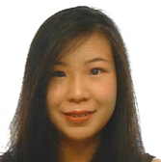

Our Graduates
Jimmy Hsu
IT Engineer
Singtel
Sam Tan
Data Analyst
SISTIC Singapore
Lee Tong Lin
Junior Software Developer
Love, Bonito
Lynette Lim
Front-End Developer
Sparkline Pte Ltd
Without prejudice to the rights of Trent Global College Of Technology & Management Pte. Ltd. ERF Validity 08 July 2019 to 07 July 2023 (Reg Num: 200400538K), the information herein is correct at the time of printing and Trent Global College Of Technology & Management Pte. Ltd. reserves the right to make, without prior notice, amendments, changes, modifications or alterations and as such there shall be no liability in respect of the said amendments, changes, modifications or alterations.

Slide 5
Zenika
Technological and organizational innovation.
Building together a simpler, more open,
freer and accessible world.
Zenika is a 500 people company specialized in software architecture and Agile methods with a threefold- -expertise in consulting, realization and training.
We have organised 680 training sessions worldwide in 2019
www.zenika.sg / www.zenika.com

Slide 6

Introduction to Golang
Charles-Henri GUERIN
Senior Software Engineer & Trainer @Zenika France, Nantes

Slide 7
What is Go?
Compiled
Concurrent
Garbage-collected
Statically typed
Efficient
Scalable
Open Source
Created at Google
Notes:
Go is a compiled, concurrent, garbage-collected, statically typed language developed at Google. It is an open source project: Google imports the public repository rather than the other way around.
Go is efficient, scalable, and productive. It is simple and easy to get started with.

Slide 8








Who uses Go?
… and many more around the world!
https://github.com/golang/go/wiki/GoUsers

Slide 9
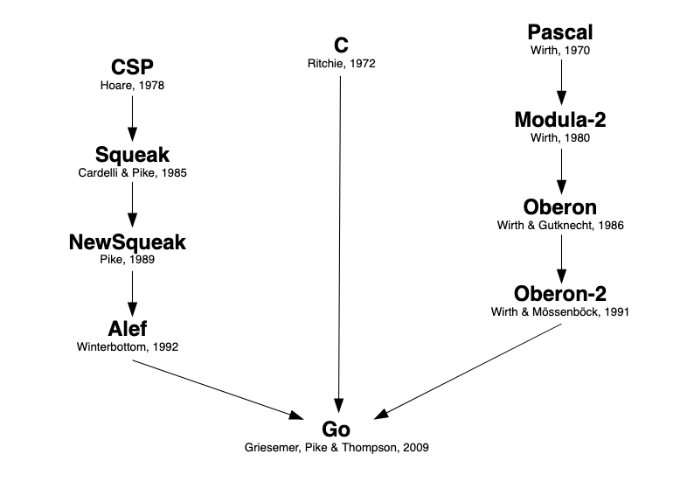
Where does Go come from?

Slide 10
Features
Garbage collection
Packages
First-class functions
Structures, interfaces…
Cross-compilation
Concurrency

Slide 11
NOT supported by Go
Implicit conversion
Constructors / Destructors
Operator overloading
Inheritance
Generics (may come with 1.17)
Exceptions

Slide 12

Play with Go!
https://play.golang.org
Notes:
Check imports: auto import
Click format

Slide 13
Package Import
Packages from the standard library are imported using their name
import "fmt"
Third-party packages are imported using their path
import "github.com/sirupsen/logrus"

Slide 14
Package Import
Members imported from a package must be qualified with the package name :
fmt.Println("Hello 🐶")
logrus.Info("Hi 🐱")

Slide 15
Package Import
Packages can be imported using a single import declaration
import (
"fmt"
"github.com/sirupsen/logrus"
)

Slide 16
Variables Declaration
Variables are declared using the keyword var
A name and a type must be specified
// var name type
var s string
var i int

Slide 17
Variables Declaration
Multiple variables can be declared using a single var
var x, y int
var (
s string
b bool
)

Slide 18
Variables Assignment
Assign a value to a variable while declaring it
// var name type = expression
var message string = "Hello World"

Slide 19
Variables 🧪
⏳ 3 min.
Declare two variables hello and world of type string
Assign them respectively with the following values: “Hello” and “World”
Print their values using fmt.Printf
💻 https://play.golang.org/p/0Jrr7VTchT0
✅ https://play.golang.org/p/Ihzn3bv8on-

Slide 20
Variables Assignment
Assign a value to a declared variable
var greeting, who string
greeting, who = "Hello", "World"

Slide 21
Type Inference
Automatic detection of the data type of a variable
var message = "Hello World" // message is a string
var i = 42 // i is an int
💻 Try removing the type string in the previous lab 🧪

Slide 22
Variables Assignment
Short variable declaration operator
x := 42 // x is an int
x, y := 6, 7 // y is also an int
💻 Goto the previous lab then remove the var keyword and use the short variable declaration operator instead

Slide 23
Constants
Defined by the keyword const
A constant is a read-only variable
It is evaluated at compile-time

Slide 24
Constants 🧪
⏳ 2 min.
Replace the keyword var with const then run the code
Assign HelloWorld with a new value right after fmt.Println then run the code again. Spoiler alert: it should fail!
💻 https://play.golang.org/p/4-Kf1h_mCIc

Slide 25
Function Definition
A function is defined using the keyword func
It can accept arguments
It can return one or more values

Slide 26
Function Parameters
func main() {} // NO parameter
func foo(bar string) {} // Single parameter
func bar(foo string, baz int) {} // Multiple parameters
func baz(foo, bar string, qux bool) {} // Shared type

Slide 27
Function Values
func main() {} // NO value
func foo() int {} // Single value
func bar() (int, string, error) {} // Multiple values

Slide 28
Function Values
Every values returned by a function must be assigned
// os.Open returns a file descriptor and an error
var f, err = os.Open(name)
Values can be omitted using the blank identifier
// Omits HTTP response
var _, err = http.Post("http://example.com/", "application/json", &buf)

Slide 29
Function 🧪
⏳ 5 min
Create a function called Hello that accepts one argument called name and returns a string saying “Hello” to the value of world.
💻 https://play.golang.org/p/XJMilpAamUv
✅ https://play.golang.org/p/KxsFsXN22rl

Slide 30
Errors
Errors are always the last returned value of a function
They are of type error and can be compared to nil
func PrintHelloWorld() error {
_, err := fmt.Println("Hello world")
if err != nil { // An error occurred
return err
}
return nil
}
Notes:
Keep things simple and see nil as null

Slide 31
Errors
Errors can be created using either errors.New or fmt.Errorf
err1 := errors.New("Something went wrong")
err2 := fmt.Errorf("File %s doesn't exist", f)

Slide 32
Types Classification
Basic: int, float, string, bool, complex
Aggregated: array, struct
Reference: pointer, slice, map, function, channel
Interface: interface
Notes:
basic and aggregated types can’t be nil

Slide 33
Numbers
Types (non-exhaustive list):
  Integers: int int8 int16 int32 int64
  Floating-point numbers: float32 float64
Default value is 0

Slide 34
Boolean
Type bool
Possible values true or false
Default value is false

Slide 35
Strings
Type string
Immutable sequence of byte
Default value is “”
Zero-based indexes
Length can be discovered using len built-in function

Slide 36
Strings
s := "hello" + ", world"
fmt.Println(len(s)) // "12"
fmt.Println(s[0], s[7]) // "104 119" ('h' and 'w')
fmt.Println(s[:5], s[7:]) // "hello" "world"

Slide 37
Strings 🧪
⏳ 5 min
Given a string containing numbers separated by commas, return a collection of string representing the same numbers.
💻 https://play.golang.org/p/fAAGTfiGihw
✅ https://play.golang.org/p/Gp1stCgqq8t

Slide 38
Type Conversion
Some of the basic types (such as numbers) can be converted to a type T using T(x) where x is the name of the variable
var i int = 42
// from int to float64
var f float64 = float64(i)

Slide 39
Type Conversion
The standard library comes with some functions to convert a basic type into another
i, err := strconv.Atoi("-42") // string to int
s := strconv.Itoa(-42) // int to string

Slide 40
Type Conversion 🧪
⏳ 5 min
Given two numbers as string, calculate the sum then return it.
💻 https://play.golang.org/p/CJeEFOJEFeG
✅ https://play.golang.org/p/shT-EAGXFol

Slide 41
If - Else Statements
Execute code when a condition is fulfilled or when it is not
Syntax is close to C but parenthesis aren’t mandatory and curly brackets are
if i % 2 == 0 {
// Divisible by 2
} else if i % 3 == 0 {
// Divisible by 3
} else {
// Not divisible by 2 or 3
}

Slide 42
If - Else 🧪
⏳ 5 min
Return true when the number is even and false when it’s odd
💻 https://play.golang.org/p/u1Qz9VthBLa
✅ https://play.golang.org/p/xJbScgRMt5E

Slide 43
Loops
Only one keyword: for
Like conditions, for is close to C
for i := 0; i < 10; i++ {
fmt.Println(i)
}

Slide 44
Loops
// equivalent to while loops
sum := 1
for sum < 1000 {
sum += sum
}
// infinite loop
for {
// Forever and ever!
}

Slide 45
Loops
A loop can be stopped using the keyword break
An iteration can be skipped using the keyword continue

Slide 46
Final 1/2 🧪
⏳ 15 min
Given a number, return:
Fizz when it is a multiple of 3
Buzz when it is a multiple of 5
the number when it’s not Fizz or Buzz
💻 https://play.golang.org/p/jhz2Fwgx-Xd
✅ https://play.golang.org/p/NwRw5-P0kYi

Slide 47
Final 2/2 🧪
⏳ 6 min
Given a number of iteration, print all the values of FizzBuzz
💻 https://play.golang.org/p/4b14zp3Q7KM
✅ https://play.golang.org/p/d0f3I3AD718

Slide 48
Key Takeaways 👍
Modern
Simple
Fast
Easy to start with
Huge community
Used and supported by a lot of companies all around the world

Slide 49
Going further 🚀
🧭 Tour of Go
📺 JustForFunc https://www.youtube.com/c/UC_BzFbxG2za3bp5NRRRXJSw
👨‍🏫 Zenika Training

Slide 50
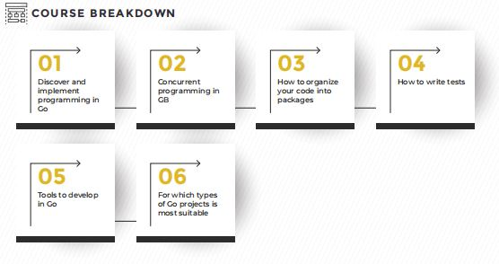
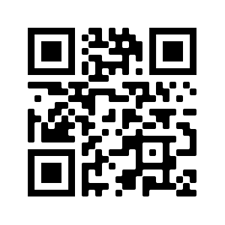

https://bit.ly/CodingMasterClass
Without prejudice to the rights of Trent Global College Of Technology & Management Pte. Ltd. ERF Validity 08 July 2019 to 07 July 2023 (Reg Num: 200400538K), the information herein is correct at the time of printing and Trent Global College Of Technology & Management Pte. Ltd. reserves the right to make, without prior notice, amendments, changes, modifications or alterations and as such there shall be no liability in respect of the said amendments, changes, modifications or alterations.

Slide 51






https://charlyx.dev

Slide 52
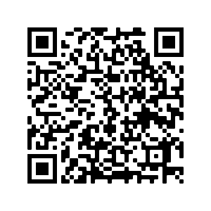
Your Feedback Matters!
Golang Course
https://bit.ly/CodingMasterClass
https://techatshopee.formstack.com/forms/shopeecodeleague_workshopfeedbackform

